Slide 1
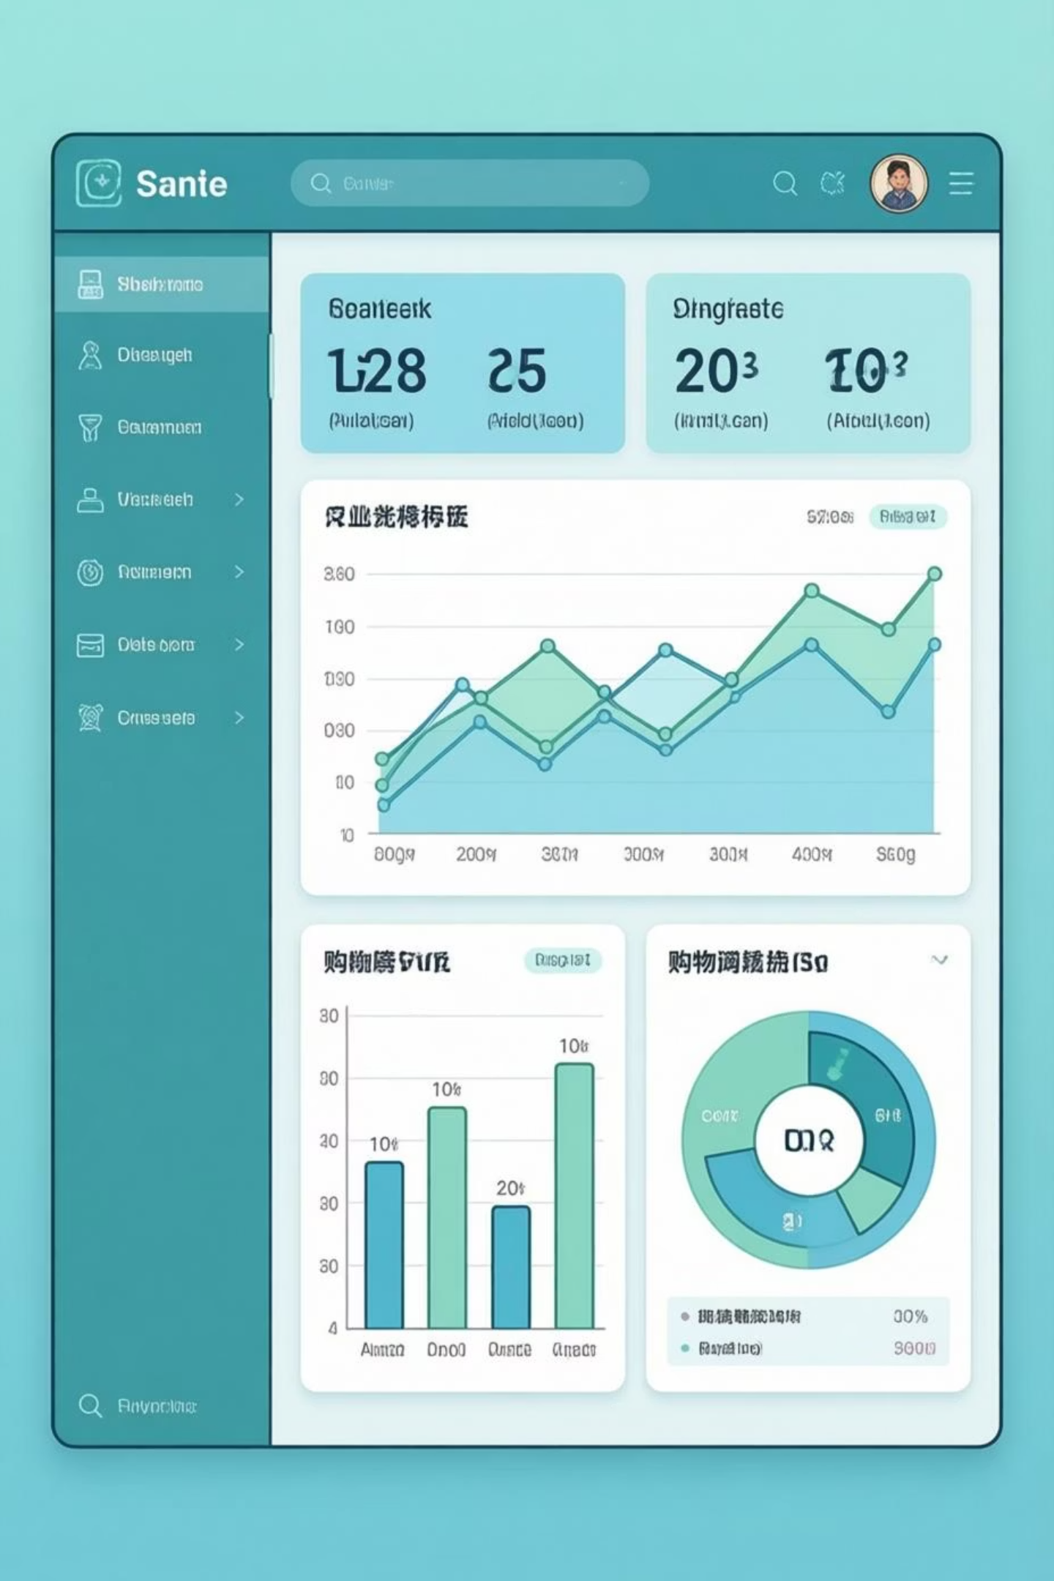
Customer Shopping Behavior Analysis
Uncovering insights from 3,900 purchases to guide strategic business decisions

Slide 2

OVERVIEW
Project Scope
Dataset Size
Data Points
3,900 purchases analyzed
Demographics, purchase details, shopping behavior
18 key features tracked
Goal
Uncover spending patterns and customer segments

Slide 3
DATA PREPARATION
Python Analysis Pipeline
01
02
Data Loading & Exploration
Missing Data Handling
Imported dataset, checked structure and summary statistics
Imputed 37 missing Review Ratings using category medians
03
04
Feature Engineering
Database Integration
Created age groups and purchase frequency metrics
Loaded cleaned data into PostgreSQL for SQL analysis

Slide 4


KEY STATISTICS
Dataset Summary
3.9K
$59.76
Customer Demographics
Age range: 18-70 years
Total Customers
Avg Purchase
Gender: 68% Male, 32% Female
50 unique locations
3.75
4 product categories tracked
Avg Rating

Slide 5
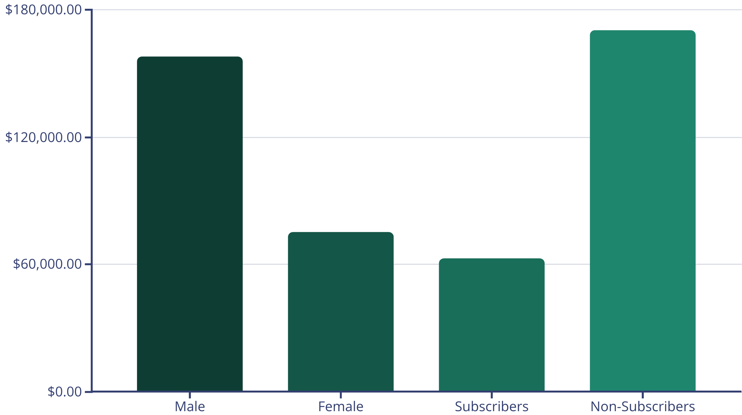
SQL INSIGHTS
Revenue Analysis
Male customers generate 2x revenue of female customers. Non-subscribers represent 73% of total revenue.

Slide 6



Customer Segmentation
New
1
83 customers
Returning
2
701 customers
Loyal
3
3,116 customers
80% of customers classified as Loyal based on purchase history - strong retention foundation

Slide 7
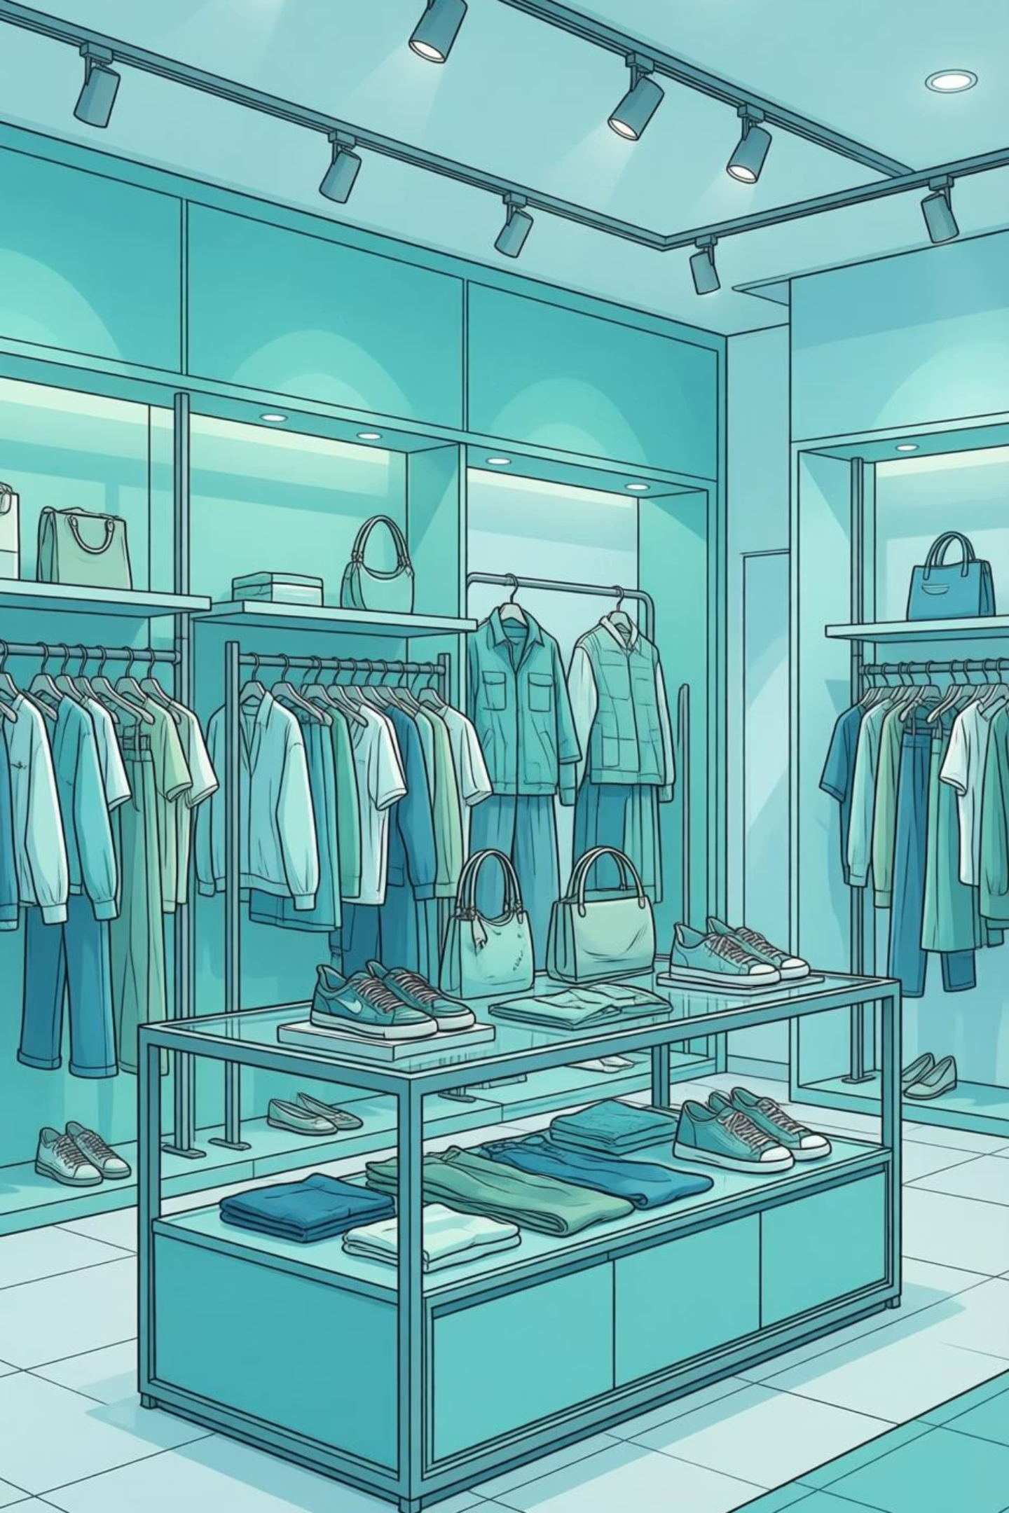
PRODUCT PERFORMANCE
Top Products & Categories
Highest Rated Items
Revenue by Category
Gloves - 3.86 rating
Clothing: $100K
Sandals - 3.84 rating
Accessories: $75K
Boots - 3.82 rating
Footwear: $30K
Hat - 3.80 rating
Skirt - 3.78 rating
Outerwear: $15K

Slide 8
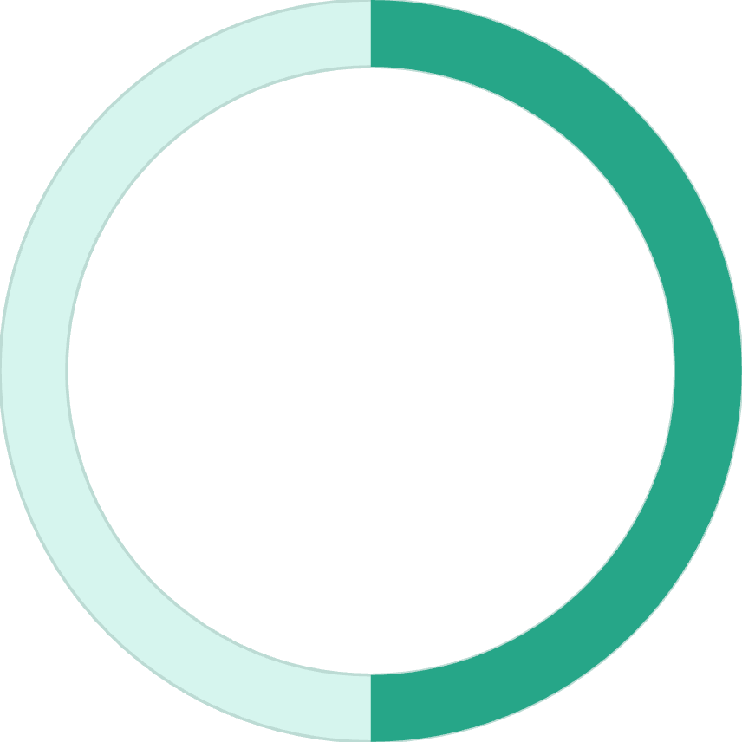
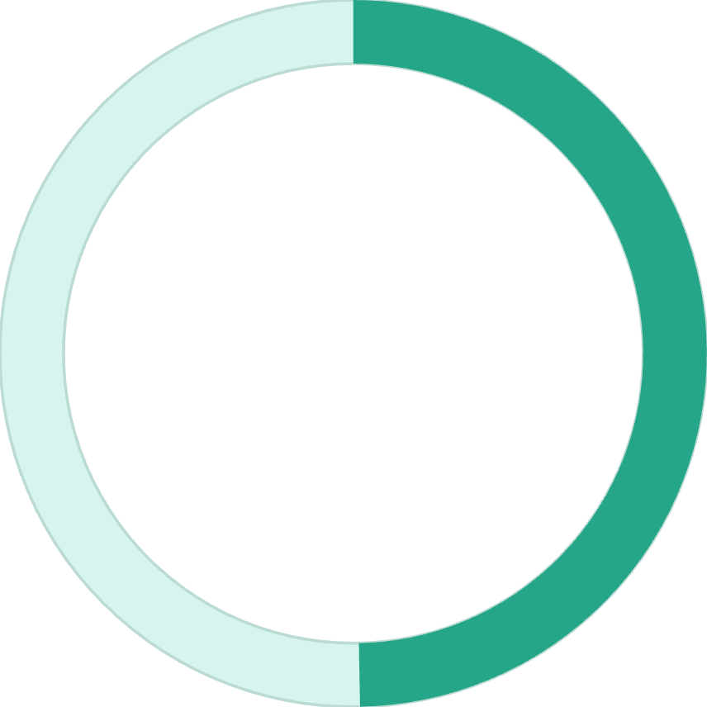
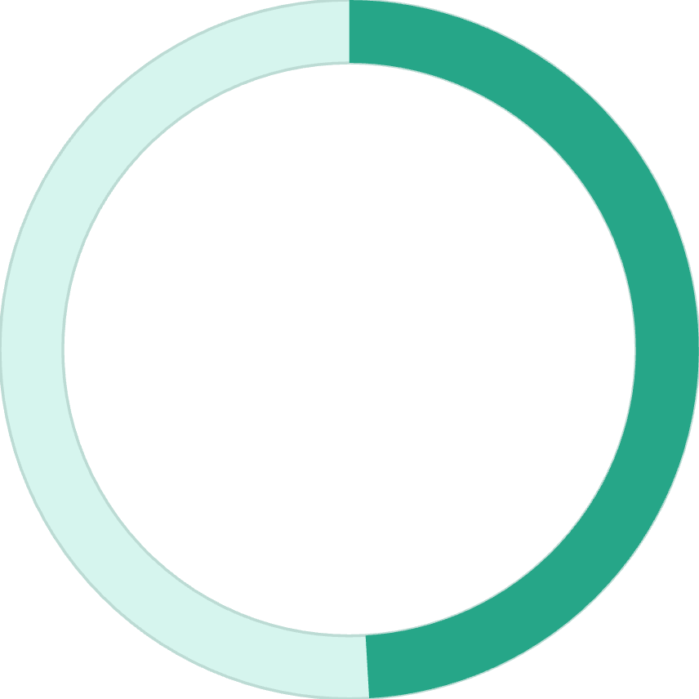

Discount Impact Analysis
50%
49.7%
49.1%
Hats
Sneakers
Coats
Highest discount rate
Second highest
Third highest
Key Finding: 839 customers used discounts but still spent above average - opportunity to optimize discount strategy

Slide 9

POWER BI
Interactive Dashboard
Dynamic Filters
Visual Analytics
Key Metrics
Subscription status, gender, category, shipping type
Revenue and sales breakdowns by age group and category
Real-time tracking of customers, spend, and ratings

Slide 10
ACTION ITEMS
Strategic Recommendations
Boost Subscriptions
Loyalty Programs
Review Discount Policy
Reward repeat buyers to strengthen the 80% loyal base
Promote exclusive benefits - only 27% currently subscribed
Balance sales boosts with margin control on high-discount items
Product Positioning
Targeted Marketing
Highlight top-rated items in marketing campaigns
Focus on high-revenue age groups and express-shipping users

